Slide 1

FIRST AID APPLICATION
Group members with Student Id
BHAVIKA KADAM(23106079)
DEEP MAGAR(23106062)
SHRADDHA BARGE(23106085)
YASH CHALKE(23106027)
Project Guide
Ms. NIRALI ARORA
Academic year 2024-25

Slide 2
Outline
Introduction
Literature Survey
Problem Statement
System Design
Technologies and Methodologies
Implementation Screenshots
Conclusion
References

Slide 3
Introduction:
In emergencies, every second counts, and having the right knowledge at your fingertips can make all the difference. This application is designed to provide you with reliable, step-by-step guidance on handling a wide range of medical situations. Whether you’re at home, at work, or out and about, our app equips you with the tools and information you need to respond effectively to emergencies.
To develop a user-friendly Android application that provides comprehensive first aid information and guidance, enabling users to respond effectively in emergencies.

Slide 4

In this Presentation, we present a first features that gives assistance to any person suffering from a sudden illness and injury in emergency case.
It will provide a simple step-by-step instructions for guide user through everyday first aid scenario

Slide 5
Literature survey of the First Aid App
Published by | Publication History/Date | Authors | Summary
International Journal of Science and Research Archive | Received: 13 Jan 2024; Revised: 19 Feb 2024; Accepted: 22 Feb 2024 | Chioma Anthonia Okolo, Oloruntoba Babawarun, Jeremiah Olawumi Arowoogun, Adekunle Oyeyemi Adeniyi, Rawlings Chidi | Mobile health apps empower users by providing access to information and tracking health metrics, improving chronic condition management, reducing costs, and facilitating communication with healthcare providers. Challenges include data privacy and unequal access. Future research should evaluate their effectiveness
IEEE | Published: 11 November 2020 | Alia Amira Abd Rahman, Mahfuzah Mohaidin, Masyarah Zulhaida Masmuzidin, | The paper proposes developing a user-friendly mobile app offering offline access to accurate first aid information, which is essential for stabilizing an injured person before medical help arrives. This app aims to improve emergency response, especially in situations where delays or a lack of knowledge can be fatal.

Slide 6
Literature survey of the First Aid App
Published By | Publication History/Date | Authors | Summary
The African Journal of Information and Communication | Published: December 2017 | Spies C., Khalaf A., Hamam Y | The study discusses a mobile app developed in South Africa as a clinical decision support system (CDSS) for untrained healthcare workers, helping them diagnose and provide basic emergency care in situations where healthcare access is limited, especially in emergencies.
Journal of Mobile Health and Technology | Published: 05 May 2019 | Johnson, M., Patel S., Williams R., Kumar N. | This study investigates the use of mobile health apps in managing diabetes, particularly focusing on tracking glucose levels, medication adherence, and lifestyle changes. The findings suggest that mobile health technologies improve patient self-management and glycemic control, reducing complications associated with diabetes.

Slide 7
Problem statement :
In critical medical situations, individuals often lack immediate access to accurate guidance and timely communication with healthcare providers, which can delay appropriate interventions and increase the risk of adverse outcomes. There is a need for a mobile application that provides users with real-time medical emergency instructions, supports communication with emergency services, and offers personalized guidance to improve response times and decision-making in urgent health crises.
In cases of accidents and injuries, taking correct first measures can prove to be critical in the healing process of the injury suffered when direct medical treatment is not immediately available. Basic first aid knowledge is a skill that is not very well equipped by the population whilst being a great factor in emergencies. How do we develop a platform for a first aid app that provides step-by-step instructions for common medical emergencies?

Slide 8
Problem Statement:
Drawbacks of Existing Apps:
Inconsistent Information Quality
Outdated Content
Limited Offline Access
Complex User Interfaces
Overwhelming Information
Lack of Personalization
Privacy Concerns
Battery Drain
No Real-Time Assistance
Advantages of our App:
Information Accuracy: Ensuring that all first aid information is up-to-date and aligns with medical guidelines.
User Engagement: Keeping users motivated to use the app and learn about first aid.
Accessibility: Designing the app to be usable for people with varying levels of medical knowledge and different age groups

Slide 9
SYSTEM DESIGN:
Functional Overview: -> The app appears to display information or content using 20 containers that have text or other UI elements. -> Users will interact with these containers, possibly scrolling through them. -> Each container may need uniform layout properties like padding, margins, and content customization.
Design Considerations -> UI Layout: You can design the 20 containers using efficient layout components like RecyclerView to manage performance and scalability, especially if the data is dynamic. -> Uniform styling can be managed through styles.xml or include layouts
Application Flow -> MainActivity: This is the main screen that loads the layout containing the 20 containers. -> Adapter (for RecyclerView): Handles loading each container’s data and updating the view. -> Data Layer: Could be from static resources (like strings.xml) or a dynamic data source (local DB or API). -> Customization via XML: Ensure that each container follows a reusable pattern (either through an included layout or a consistent style).

Slide 10
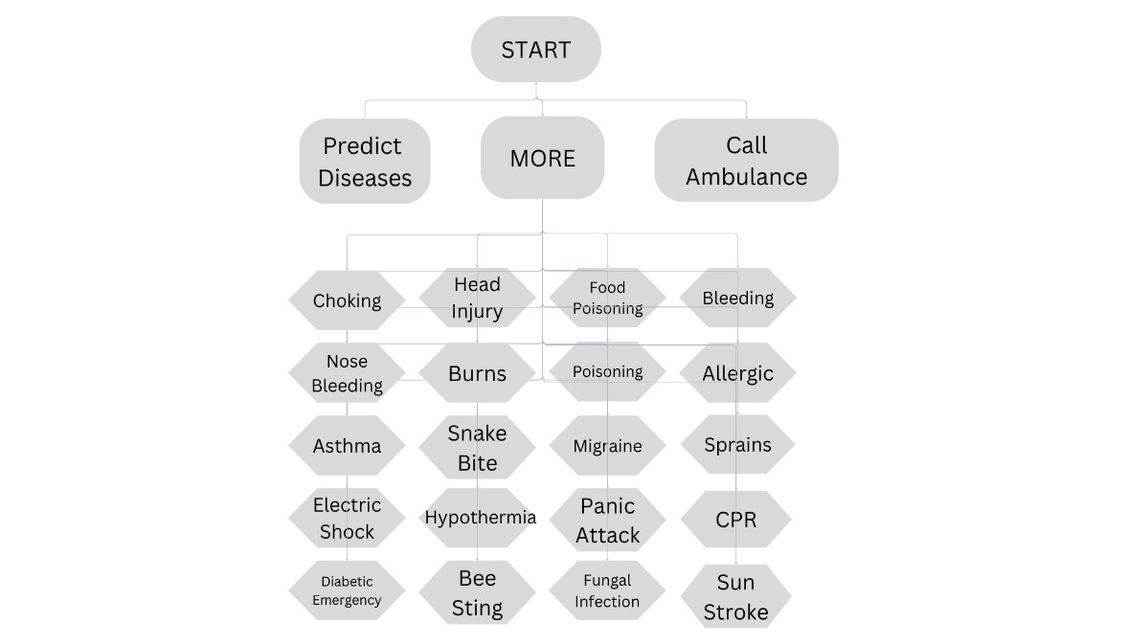
This flowchart outlines a decision-making process for addressing various emergency medical situations.
The flowchart is designed to quickly guide a person to the correct emergency response or to direct them to call for an ambulance in life-threatening situations.

Slide 11
Software Setup:
Android Studio
Setup: Install the latest version of Android Studio (Bumblebee or newer).
SDK Tools: Ensure that Android SDK, build tools, and emulators are installed.
Use Gradle for project building and dependencies. You may need the following dependencies in your build.gradle file
2. Version Control
Git for managing version control and collaborating with other developers.
You can use platforms like GitHub or GitLab for remote repository management.
Hardware Setup:
1. Developer Machine
Processor: Minimum Intel i5 or AMD Ryzen 5 or better.
RAM: Minimum 8 GB (recommended 16 GB) for running Android Studio smoothly.
Storage: At least 10 GB of free SSD storage for Android Studio, SDKs, and emulators.
Graphics: Integrated or dedicated GPU for better performance while running emulators.
2. Test Device
Android Phone/Tablet: Any Android device with at least Android 5.0 (API 21) for testing the app on real hardware.
Emulators: Android Studio provides emulators to simulate various device configurations for testing.

Slide 12
Technologies and Methodologies
Technologies:
Java: The primary programming language used to write the app's logic, manage the user interface, and handle interactions.
XML: Used for designing layouts, defining UI components such as buttons, text views, and containers.
Gradle: A build system used for compiling the app, managing dependencies, and packaging it for deployment.
APIs (if applicable): Any external services or libraries integrated into the app, such as for networking or accessing device hardware.
Material Design: Used to define the visual elements and interactions to ensure the app follows the Android design guidelines.
Android Studio: The integrated development environment (IDE) for building, testing, and debugging the app.

Slide 13
Methodologies:
Agile Development:
An iterative approach to app development, allowing frequent updates and
collaboration between the development team and stakeholders. Features
are delivered in small, incremental releases.
2. Model-View-View-Model (MVVM) Architecture:
A design pattern that separates the app’s logic (ViewModel) from the user interface (View), making the code more modular, testable, and easier to maintain.
3. User-Centered Design (UCD):
Focuses on designing the app by keeping the user’s needs in mind. Iterative testing and feedback loops ensure the app remains user-friendly and intuitive.
4. Modular Programming:
Breaking down the app's functionality into independent, interchangeable modules to ensure easy updates, debugging, and scaling of the app.
5. Test-Driven Development (TDD):
Writing tests before developing the features to ensure every piece of code
works as expected, improving the reliability and maintainability of the app.
6. Continuous Integration/Continuous Deployment (CI/CD):
Automating the integration of code changes and deployment of builds. Ensures faster delivery, automated testing, and continuous updates to the app.

Slide 14
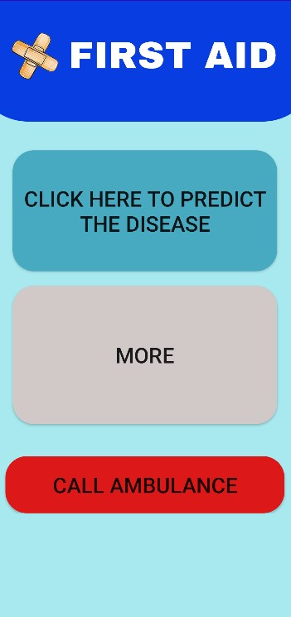
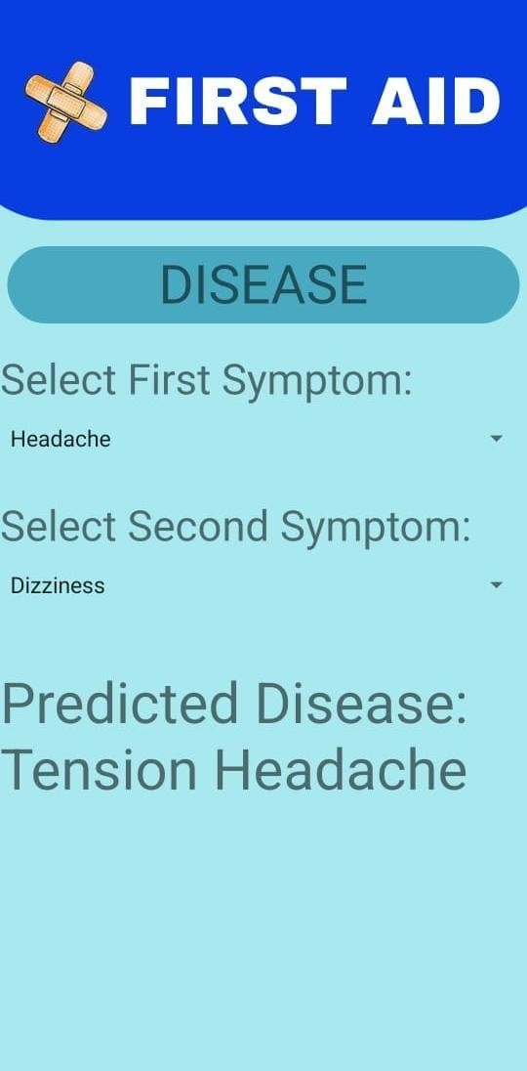
Implementation:
1. Scenario after clicking on PREDICT DISEASE :

Slide 15
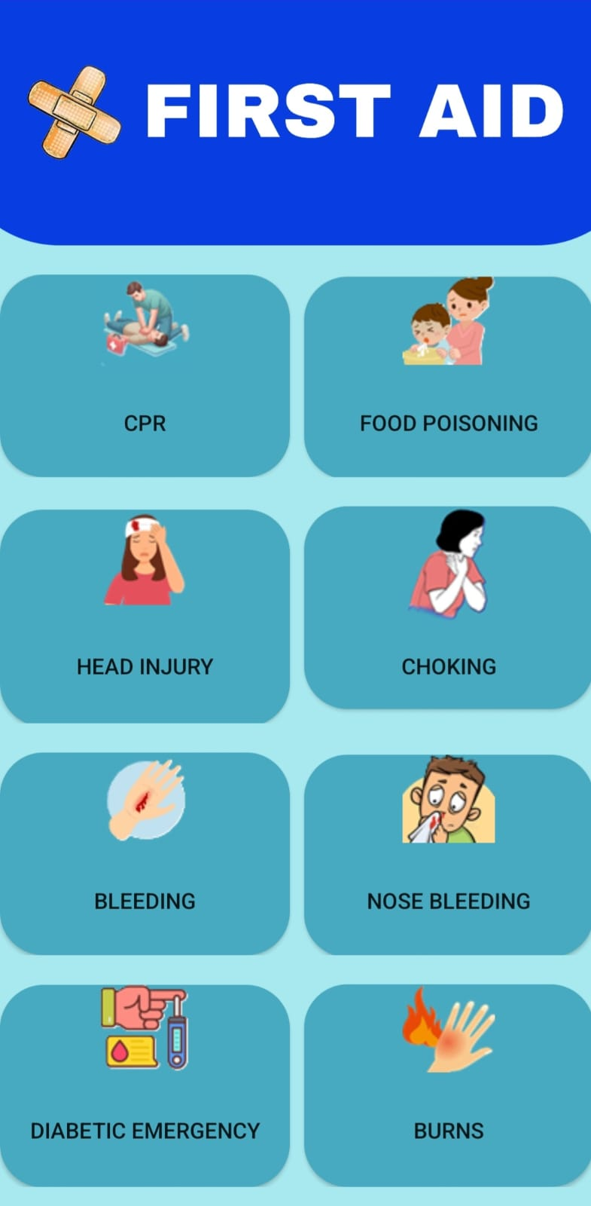
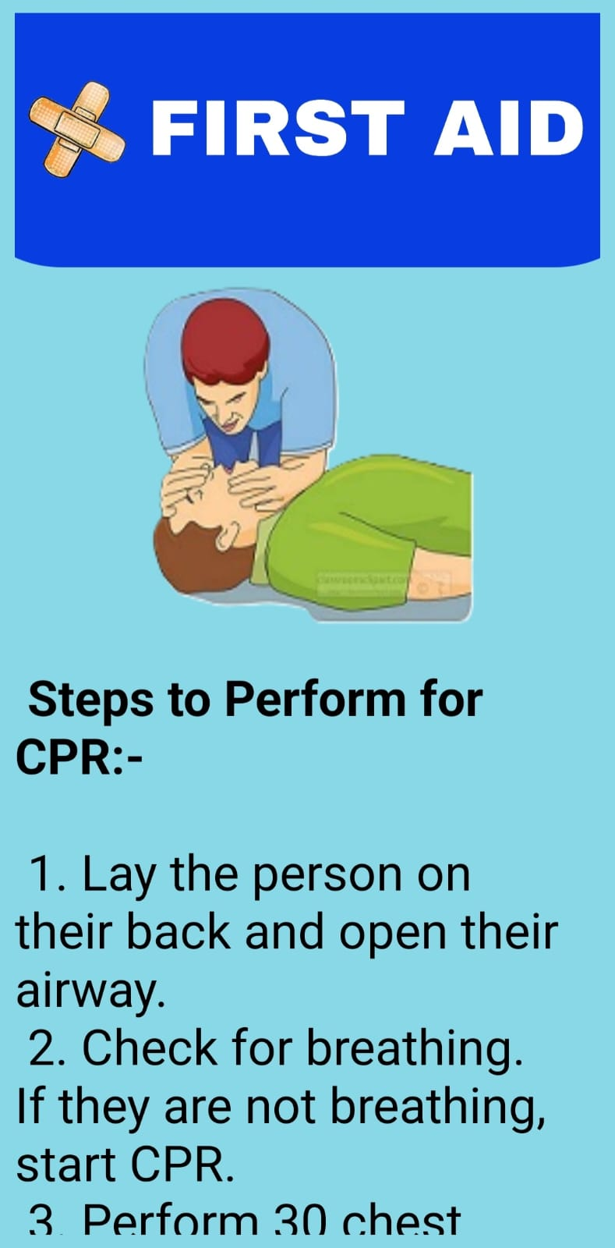
Implementation:
2. Scenario after clicking on MORE:

Slide 16
Conclusion:
The development of this first aid mobile application addresses a critical need for accessible, real-time medical guidance during emergencies. By providing offline functionality and user-friendly features, the app ensures that individuals can respond effectively to health crises, even in areas without internet access. This app aims to bridge the gap in emergency response by offering accurate, up-to-date information and step-by-step instructions, empowering users to take timely action and potentially save lives before professional medical help arrives. Ultimately, it contributes to enhancing public health and safety by improving first aid response and reducing delays in medical care.

Slide 17
References:
[1] World Health Organization (WHO) - First aid guidelines and
best practices. WHO Guidelines on Basic Emergency Care URL: WHO Basic Emergency Care
[2] American Red Cross - First aid app and resources for
emergency situations. American Red Cross First Aid App Overview URL: https://www.redcross.org/
[3] National Institutes of Health (NIH) - Guidelines and articles on
first aid and emergency care. NIH: First Aid Information URL: https://www.nih.gov/

Slide 18
Thank You...!!

